Slide 1
PowerShell Workshop
Getting Started

Slide 2


PowerShell Workshop
Getting started
Jeffrey Snover
Jason Helmick
Technical Fellow/Microsoft
Author/Pluralsight
@JSnover
@theJasonHelmick

Slide 3
Where can I get the slides and labs?
http://Github/theJasonHelmick/SpiceWorld

Slide 4
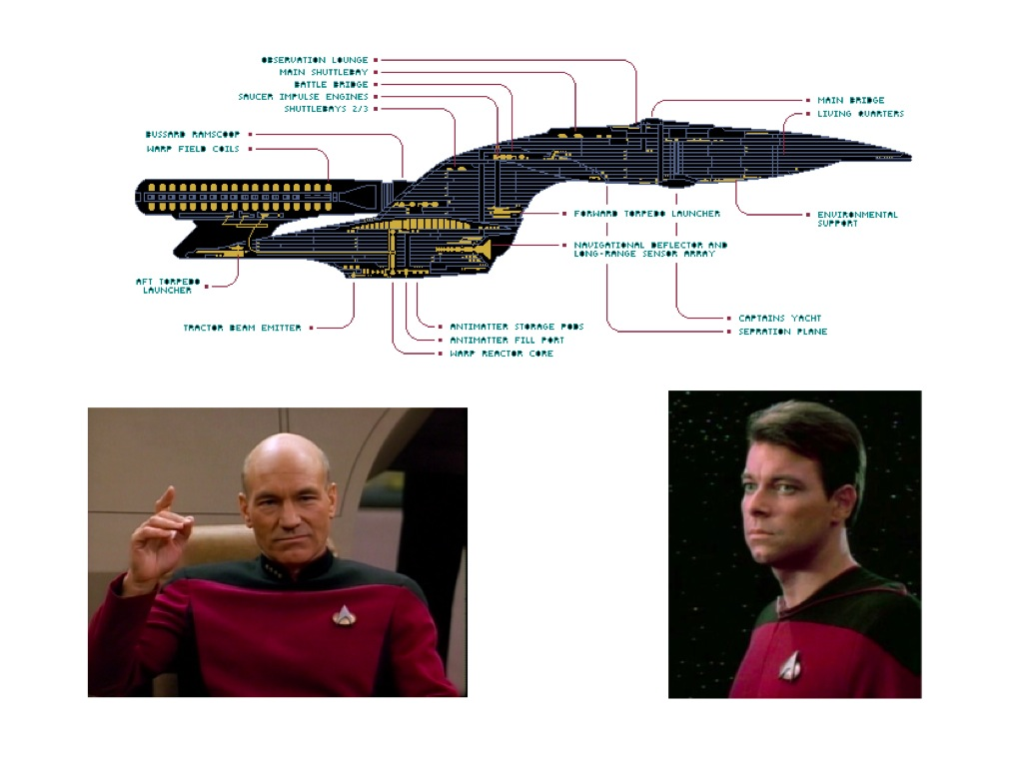
Make it so…

Slide 5
This directly impacts the security of your company and its assets
This will prevent rogue administration
Reduce outages due to mistakes
Reduce Malware impact
Why This Is so Important

Slide 6
Role Based Access Control (RBAC) models
Reduce the number of Administrators
Limit and control what Administrators can perform
Understand exactly what Administrators are doing
JEA as a Security Model

Slide 7


PowerShell Remoting
System 1
Endpoint
PowerShell
PS:> Get-Service –Name Spooler
PS:> Restart-Service –Name Spooler
Client
System 2
PowerShell
PS:> Get-Service –Name Spooler
PS:> Restart-Service –Name Spooler
System 3
PowerShell
PS:> Get-Service –Name Spooler
PS:> Restart-Service –Name Spooler

Slide 8
PowerShell Remoting with JEA
System 1
Endpoint
PowerShell
PS:> Get-Service –Name Spooler
Custom
Endpoint
PS:> Restart-Service –Name Spooler
Client
Session Configuration
Defines who and how
Specific to each machine
(.pssc) file
Role Capability
Defines what users can do
Can be shared across environment
(.psrc) file

Slide 9

JEA and Virtual Accounts
System 1
Endpoint
PowerShell
PS:> Get-Service –Name Spooler
Custom
Endpoint
PS:> Restart-Service –Name Spooler
Client
Virtual Accounts
One time privileged account
Runs under local Administrator
Can be configured for other accounts
Regular user account
Currently does not work for Windows 7 or Windows Server 2008R2

Slide 10
Concept: Just In Time (JIT)
System 1
Endpoint
PowerShell
PS:> Get-Service –Name Spooler
Custom
Endpoint
PS:> Restart-Service –Name Spooler
Client
JEA Print Operators
Regular user account

